Slide 1
JavaScript - UFO hunter game Creating Enemies

Slide 2

Create enemies - The UFOS
8 columns
width = 32 px
4 lines
height = 24 px

Slide 3
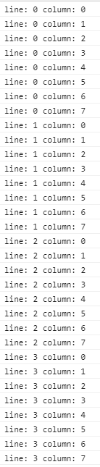
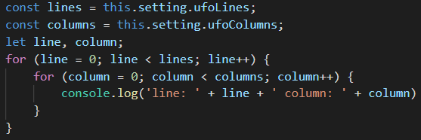
Create enemies - Nested loop of UFOS
8 columns
4 lines

Slide 4
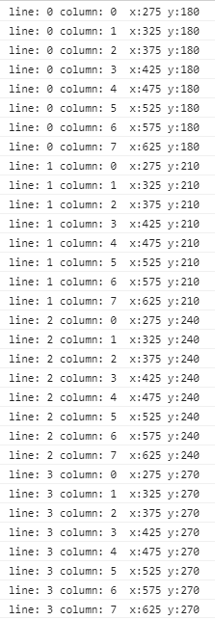

Create enemies - Starting positions
0
900 px
center: 450
top: 150
active playing field
750 px

